Slide 1
CMPT439 - Numerical Comp
Final Project
Solving nonlinear equations
By Alex Gibbons and Kieran OGara

Slide 2
Introduction
This program is designed to retrieve roots from nonlinear equations
To achieve this, four different methods have been implemented into the code
Bisection Method
False Position Method
Secant Method
Newton Method
The user will be able to choose which method they would like to use, as well as the choice between three different types of errors
Absolute Approximate Error
Absolute Relative Approximate Error
True Absolute Error

Slide 3
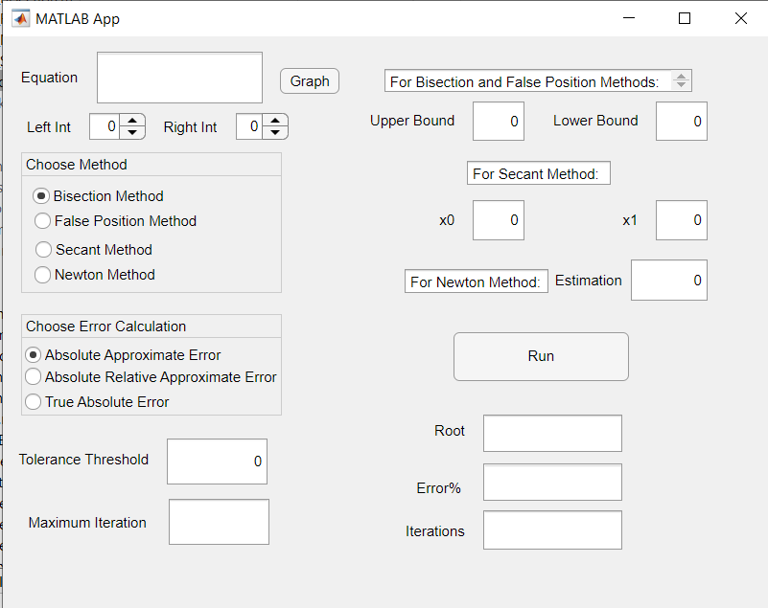
The Main Program - GUI
When the program begins the user will be prompted with the box on the right
They will first be able to enter an equation then using the two spinners below, a left and right interval of the x axis can be set and easily modified
Next the user can select their choice of methods from the box below
Followed by their desired stopping criterion
Below that they can enter desired tolerance threshold and the max number of iterations
If the user wishes to use max it as their stopping criterion, they may choose to leave tolerance at 0
Max iterations will always be set to 50 if the box is left empty

Slide 4
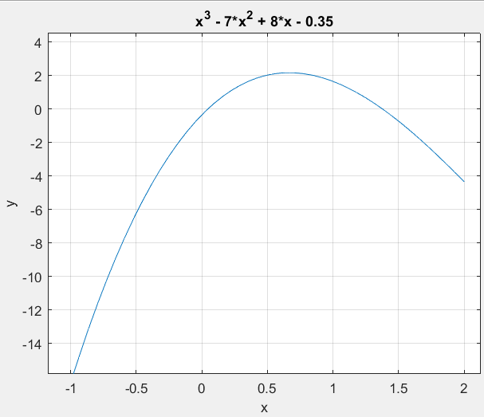
GUI - Graphing
Here is an example of the graph button in process
The user will now accurately be able to make initial guess
We felt this was an important feature since the initial guesses are very important
They are especially crucial for the Bisection and False-Pos methods since the bounds must be on either side of the root
From this graph, initial guesses in the range -.5 to .5 would be favorable

Slide 5
GUI cont.
The upper right portion of the GUI is dependent on what method the user chooses
If they choose Bisection or False Position they must enter an upper and lower bound
For secant method two initial guess must be entered
And for Newt-Raph, a single initial estimation is required
After all required information is entered user can press Run
The results will be displayed in the bottom right portion

Slide 6
Bisection Method
One of the two Bracketing Methods
Method based on making two initial guesses on either side of the root
In the case of the Bisection method, one guess for the x value must be positive and one must be negative.
f(xl) * f(xu) < 0
The Bisection method relies on three main criteria
The root f(x) = 0 exists between the two points
The function f(x) is real and continuous
The function f(x) changes signs between the to initial brackets

Slide 7
Bisection Method: How it Works
The programs requires at least 4 main parameters to function:
1. func- the function f(x) in which the root is found
2. xl- the lower bound x-value (this value must have a negative sign)
3. xu- the upper bound x-value (this value must have a positive sign)
4. err_type- Integer value to determine which error type would be used as a stopping criterion
1= True Error
2= Absolute Approximate Error
3= Absolute Relative Approximate Error
2 optional parameters
es- the threshold parameter for the error calculation (default value = 0.0001)
maxit- the maximum number of iterations the program is allowed to go through before forcing it to stop (default value = 50)

Slide 8
Bisection Method: Algorithm to Code
The program first makes sure that f(xl) * f(xu) < 0
test = func(xl,varargin{:})*func(xu,varargin{:});
if test>0,error('no sign change'),end
The remaining code is performed within a while loop, with each loop representing an iteration of the method
The root is first estimated as f[(xl + xu) / 2] , or f(xr)
If f(xl) * f(xr) < 0, then the root lies between xl and xr, making xr the new upper bound
If f(xl) * f(xr) > 0, then the root lies between xr and xu, making xr the new lower bound
If f(xl) * f(xr) = 0, then the root has been found the the loop ends
After each loop, xr is used to calculate the error, which is compared to the tolerance threshold. If this or the number of maximum iterations (maxit) it met, the loop ends the xr is the determined root

Slide 9
Bisection: Advantages and Disadvantages
Advantages:
If the brackets are in the correct position, the method will always converge onto the root regardless of the threshold value
The potential position of the root between the brackets is always halved between each iteration
Disadvantages:
Usually requires more iterations to find root than other methods
The speed of the method is also heavily determined by how close or far away the initial brackets are to the root
Bisection cannot be used for functions that either only touch the x-axis or if no root exists to begin with

Slide 10
False Position Method
The second of the two Bracketing Methods
Like the Bisection Method:
Requires that the root between two bracket points of opposite sign
Unlike the Bisection Method:
Each step of the False Position Method takes the x-axis intersection point of the line formed by the x-values
Root is approximated using linear interpolation:
The line between f(x0) and f(x1) is used to approximate a value x2 at which f(x2) = 0

Slide 11
False Position Method: How it Works
The program requires at least 4 main parameters to function:
1. func- the function f(x) in which the root is found
2. xl- the lower bound x-value (this value must have a negative sign)
3. xu- the upper bound x-value (this value must have a positive sign)
4. errType- Integer value to determine which error type would be used as a stopping criterion
2 optional parameters
es- the threshold parameter for the error calculation (default value = 0.0001)
maxit- the maximum number of iterations the program is allowed to go through before forcing it to stop (default value = 50)

Slide 12
False Position Method: Algorithm to Code
The program first calculates that f(xl) * f(xu) < 0
test = func(xl,varargin{:})*func(xu,varargin{:});
if test>0,error('no sign change'),end
Save the value of x1 in new variable x
The remaining code is performed within a while loop, with each loop representing an iteration of the method
Find the value of x1 - f(x1) * ((x0-x1) / (f(x0) - f(x1)))
xi = xu - (func(xu,varargin{:}) * ((xl - xu)/(func(xl,varargin{:}) - func(xu,varargin{:}))));
If f(x0) * f(xi) < 0, set x1 = xi. Else, set x0 = x2.
The next step is determined by the error type used:
For true error:
if |f(x2) <= the tolerance threshold, stop the loop and set x2 as the root. Else, repeat the loop.
For absolute approximate error and absolute relative approximate error:
If |x - x2| <= the tolerance threshold, stop the loop and set x2 as the root. Else, set x = x2 and repeat the loop

Slide 13
False Position Method: Advantages and Disadvantages
Overall, the advantages and disadvantages are similar to the Bisection Method
Advantages
Faster convergence time that the bisection method
If the function allows it, convergence on a single root is guaranteed
Disadvantages
While faster than bisection, it is still slower than other convergence methods. This is due to a linear rate of convergence
Cannot find complex roots or the roots of discontinuous functions

Slide 14
Secant Method
An iterative method used to solve nonlinear equations
Uses a process of approximating linear functions that fall closely in line with the nonlinear function at its root
Falls under the open method category
Is not bounded by intervals like the Bisection and False Position methods
Uses 2 initial guesses to start
Convergence is not guaranteed so a proper guess must be made from available information
Best way to do this is by plotting a graph of the function

Slide 15
Secant: How it works
Before the program begins, it requires at least 4 parameters but can take 6
1. func - The formula of a nonlinear function
2. x0 – an initial lower guess
3. x1 – an initial upper guess
4. opt – this determines what error will be used as stopping criterion
Opt = 1 -> Absolute Approximate Error
Opt = 2 -> Relative Approximate Error
Opt = 3 -> True Error Value
5. es *optional* – desired error threshold (if left empty, def = 0.0001%)
6. maxit *optional* – desired num of max iterations before terminating(if left empty, def = 50)

Slide 16
Secant: The Algorithm
The program will first determine which root is closest to 0 when passed to function
If |f(x0)| < |f(x1)|, then the two will be swapped
A loop will begin to retrieve the true root, or closest possible
Step 1: x2 = x1 – f(x1)*((x0-x1)/f(x0)-f(x1))
x0 = x1 and x1 = x2
get f(x2) -> will be used for True Error Value
increase num iterations
Step 2: Calculate error
Depending on which option chosen…
ea = |x0 – x2|
er = |(x0-x2)/x0|
tv = |f(x2)|
If any of the errors fall below es(predetermined error threshold) x2 is a root and program should be terminated
Else, go back to Step 1

Slide 17
Secant: Advantages and Disadvantages
The secant method for the most part will converge faster than most of the other nonlinear equation solvers
This is greatly dependent on the function itself
if a function is not close to being linear near the root, this method is more likely to stop from max number of iterations than if it were to find a root

Slide 18
Newton-Raphson Method
Like the secant method, it’s another type of open method for finding a root to a nonlinear equation
Since this method utilizes tangent lines to find the root it requires the derivative of the nonlinear function as well
Note: This method is not suited for functions with non-analytically evaluated derivatives
Only uses a single initial guess
Graph the function first for best results

Slide 19
Newt-Raph: How it works
Also like the Secant method, it requires 4 parameters
1. func - equation of the nonlinear function
2. dfunc - derivative of the nonlinear function
3. xr - initial guess
4. opt – this determines what error will be used as stopping criterion
Opt = 1 -> True Error Value
Opt = 2 -> Absolute Approximate Error
Opt = 3 -> Relative Approximate Error
5. es *optional* – desired error threshold (if left empty, def = 0.0001%)
6. maxit *optional* – desired num of max iterations before terminating(if left empty, def = 50)

Slide 20
Newt-Raph: The Algorithm
Step1: Store xr into xold
Step 2: Find a new xr
xr = xr - f(xr)/df(xr)
Increment num iterations
Step 3: Calculate error
Depending on which option chosen…
ea = |xr – xrold|
er = |(xr-xrold)/xr|
tv = |f(xr)|
If any of the erros fall below the predetermined threshold, es, then xr is the root and the program should terminate
Else, return to step 1

Slide 21
Newt-Raph: Advantages
With the proper initial guess, it will converge faster than all other methods… if convergence is possible
This is due to a process called quadratic convergence
The square of the error at one iteration is proportional to the error at the next
For example:
if at iteration 1 the error is 2.2x10^(-2)
At iteration 2 the error will be (2.2x10^(-2))^2 or 4.84x10^-4
It is also possible to retrieve complex roots of an equation through this method
The sum of any real number and a pure imaginary number

Slide 22
Newt-Raph: Disadvantages
Requiring the derivative of a function may cause issues for more complicated equations
It is way too dependent on its initial guess
While it generally is the fastest to converge, there are a few instances where if given the wrong initial guess it will converge much slower, or not converge at all
It often overshoots at inflection points and then will diverge away from the root
Division by zero is very real possibility and will result in the function failing altogether
It may overshoot the intended root and retrieve a different root

Slide 23
Conclusion
There is no definite BEST method for solving nonlinear equations
Each method has areas where it is better suited than the others, but there are also situations for each where it may fail or it is nowhere near the best option
The method picked is heavily dependent on the equation being evaluated, as well as the initial x values used

